Slide 1
Responsible AI ecosystems: plural logics in banking and insurance
FLAIG Work Package 2
FLAIG Summit, 3 November 2026
Matti Minkkinen, Assistant Professor
University of Turku
Notes:
[0:00–0:20]
• Matti Minkkinen, University of Turku — WP2: AI governance across organizations

Slide 2
Why an ecosystem view?
A bank or insurer can’t govern its AI alone
E.g., the bank can’t decide by itself…
“AI systems are often developed by one organization, deployed by another, audited by third parties, and regulated by governments.”
whether the foundation model it licenses was trained responsibly (upstream)
whether the supervisor accepts its explanation of a credit decision (scrutiny)
whether there is an auditor who can certify its AI management system (assurance)
whether customers will trust an automated decision (customers)
→ AI governance is “fundamentally an interorganizational phenomenon”
Khan & Mäntymäki (2026)
Notes:
[0:20–1:35]
• A bank can write an AI policy, set up a governance committee, document its models…
• …but it can't decide these four things alone — [read them as written, they preview the model]:
– upstream: was the licensed foundation model trained responsibly?
– scrutiny: does the supervisor accept its explanation of a credit decision?
– assurance: is there an auditor who can certify its AI management system?
– customers: will they trust an automated decision?
• Quote: developed by one, deployed by another, audited by third parties, regulated by governments → "fundamentally an interorganizational phenomenon"
• Organizational AI governance is only half the picture — that's the gap WP2 looks at

Slide 3
Two outputs to help organizations navigate plural logics
1
What does the responsible AI ecosystem look like around a bank or insurer?
2
How should a bank or insurer position itself in it?
Preliminary
Responsible AI ecosystem model
AI ecosystem strategy framework
three layers + two governance patterns + four institutional logics + translation
seven decision areas × three positioning options for navigating plural logics
Built by synthesis from FLAIG studies:
Layered institutional perspective
Minkkinen et al., 2026
Interorganizational governance patterns
Khan & Mäntymäki, 2026
Translation in Nordic organizations
Birkstedt et al., 2026
Two MSc theses + GenAI expert study
Heikkilä; Huopalainen; Jylhä et al., 2026
Full WP2 deliverable: Responsible AI Ecosystems in Banking and Insurance: An ecosystem model and a strategy framework
Notes:
[1:35–2:25]
• Two questions:
1. What does the ecosystem around a bank or insurer look like? → ecosystem model
2. How should the firm position itself in it? → strategy framework
• "Plural logics": several valid ways to frame what the problem and the answer are — more on slide 7 [don't explain here]
• A synthesis, not from scratch: three FLAIG studies (two at I3E this year), two MSc theses, the GenAI expert study
• Preliminary

Slide 4
What do we mean by “ecosystem”?
An ecosystem is the structure of actors, relationships and institutions that must align for AI in the sector to be responsibly governed and audited
1
It’s a structure defined by who needs to align
What matters is who needs to align for the value proposition (responsibly governed AI) to materialize.
Adner, 2017
E.g., supervisors and standard-setters, even without a contract
2
Rules and standards are part of it
Regulation, standards and supervisory expectations are part of the ecosystem, not an external constraint on it.
Granstrand & Holgersson, 2020; Tsujimoto et al., 2018
Especially important in a heavily regulated sector
3
Its actors reason differently
No one orchestrates the responsible AI ecosystem, so these differences aren’t smoothed out from above.
Thornton & Ocasio, 1999; Minkkinen et al., 2023
E.g., a supervisor and a data scientist disagree on what justifies using a model
Notes:
[2:25–3:40]
• "Ecosystem" is used loosely in policy talk (EU "ecosystem of trust") — here in the business-ecosystem sense
• Adner: defined by who needs to align for a value proposition to materialize — here, responsibly governed AI
• Three things follow:
1. A structure: includes actors with no contract with the bank — e.g., supervisors, standard-setters
2. Institutions: regulation and standards are part of the ecosystem, not an outside constraint — key in a heavily regulated sector
3. Actors reason differently: supervisor vs. data scientist on a black-box credit model — "it works" vs. "can it be explained?"
• Nobody orchestrates the responsible AI ecosystem (our 2023 paper) → differences aren't smoothed out from above; firms keep meeting them

Slide 5
Responsible AI ecosystem model
Polycentric governance
supervisors, auditors, standard-setters, civil society
act on the firm from outside
requirements (translated, not simply applied)
evidence
Bank / insurer
plural logics meet and are negotiated
Upstream
cloud, model & system providers
oversight
Downstream
customers, policyholders
prepare
feed back
AI ethics principlism
Managerial rationalism
Insurers & reinsurers
risk alleviation
Value chain governance
runs through the firm
pricing
IT professionalism
Regulatory oversight
controls
system properties
AI systems in use
credit scoring, claims, fraud, chatbots
Birkstedt, T., Minkkinen, M., & Mäntymäki, M. (2026). Governance by negotiation. I3E 2026, LNCS 16912, 301–312.
Khan, F., & Mäntymäki, M. (2026). Interorganizational AI governance in academic and grey literature. I3E 2026, LNCS 16912, 326–336.
Minkkinen, M., Jylhä, H., & Mäntymäki, M. (2026). AI governance: A layered institutional perspective. Working paper, University of Turku.
Notes:
[3:40–6:25]
• Bank or insurer in the middle; three layers: ecosystem, organization, AI systems
• TOP — polycentric governance = AUTHORITY: who outside the firm gets to look and judge?
– supervisors, auditors, standard-setters, civil society
– many centres, formally independent, but within a common framework (Ostrom)
– requirements come down, evidence goes up — translated, not simply applied
• MIDDLE ROW — value chain governance = OBLIGATION; the direction differs:
– Upstream (cloud, model, system providers): one-way oversight — e.g., contracts
– Insurers & reinsurers: risk alleviation — cover alleviates risk, pricing gives an incentive to reduce it → insurance as a governance mechanism; still evolving
– Downstream (customers, policyholders): two-way — they transact and oversee at the same time; feed back expectations, trust or distrust
• BOTTOM — AI systems in use (credit scoring, claims, fraud, chatbots): the firm governs them through controls; their properties push back (opaque, learning)
• INSIDE — four logics meet and are negotiated → next slide [don't go through them here]
• Message: a bank's responsible AI position depends less on its internal framework than on how it's placed in, and acts on, this structure

Slide 6
Four institutional logics: how different actors reason
AI ethics principlism
Managerial rationalism
IT professionalism
Regulatory oversight
Civil society, academia, affected groups
Reason in terms of fairness, transparency, non-maleficence
Investors, managers, deployers
Reason in terms of efficiency, ROI, cost control, risk management
Standard-setters, developers, providers
Reason in terms of technical effectiveness, testing, sound methods
Supervisors, auditors, review boards
Reason in terms of compliance, enforcement, standardization
When plural logics meet inside the firm
Financial risk management: treated here as a hybrid
Loose coupling — fine on the surface, diverging underneath (Berente & Yoo, 2012)
Polarization, compromise or synthesis — issue by issue (Boonstra et al., 2018)
Hybrid professionals as brokers — until conflict gets too intense (Bernardi & Exworthy, 2020)
Regulatory oversight
+
Managerial rationalism
Risk officers, actuaries, compliance
Reason in terms of risk appetite, capital adequacy, prudence
Minkkinen, M., & Mäntymäki, M. (2023). The institutional logics underpinning organizational AI governance practices. SCIS 2023.
Minkkinen, M., Jylhä, H., & Mäntymäki, M. (2026). AI governance: A layered institutional perspective. Working paper, University of Turku.
Notes:
[6:25–8:25]
• Four coherent views of what counts as responsible AI, each with its own source of legitimacy:
– AI ethics principlism: ethical expertise
– Managerial rationalism: efficiency, ROI — so self-evident it's easy to overlook
– IT professionalism: technical competence
– Regulatory oversight: the force of law
• A supervisor's requirement carries a logic and meets the other logics inside the bank. Ideally they point the same way — the interesting cases are the clashes
• Three well-known outcomes from IS research:
– Loose coupling: compliant on the surface, diverging underneath — the letter, not the spirit
– Polarization, compromise or synthesis, issue by issue — e.g., black-box credit model: "too opaque, we can't use it" vs. "it's the most efficient, competitors use it"
– Hybrid professionals as brokers: law, IT and ethics speak different languages → brokering grows in value (until conflict gets too intense)
• Banking & insurance's own risk logic = hybrid of regulatory oversight + managerial rationalism, carried by risk and actuarial functions and insurers' pricing

Slide 7
AI governance requirements are continuously translated
27 expert interviews in 23 Nordic organizations on how AI governance requirements are turned into practice
1
Regulation is non-negotiable…
… but firms translate it differently, system by system and use case by use case (rather than through organization-wide rules).
“Regulatory or administrative pressure blocks quite clearly any black box AI and drives us more towards rule-based solutions.”
2
Stable translation needs a stable spokesperson
E.g., an AI governance function or committee with explicit decision rights. Without one: “repeated re-negotiation of the same governance issues”.
Banking informant
So what? Logics + translation explain why the same pressure leads to different responses → translation capacity is a strategic choice
3
AI systems shape their own governance
E.g., opaque models led to rule-based fallbacks and limits on what can be delegated (the bottom-up arrow in the model).
Birkstedt, T., Minkkinen, M., & Mäntymäki, M. (2026). Governance by negotiation: How organizations translate AI ethics into practice.
I3E 2026, LNCS 16912, 301–312.
Notes:
[8:25–9:55]
• "Translation" on purpose: requirements aren't implemented like a specification in code
• 27 interviews, 23 Nordic organizations — three findings:
1. Regulation is non-negotiable, but firms translate it differently, system by system, use case by use case
2. Stable translation needs a stable spokesperson — an AI governance function or committee with decision rights; otherwise the same issues get renegotiated again and again
3. AI systems shape their own governance — the bottom-up arrow. READ THE QUOTE
• SO WHAT — say it as a statement: logics + translation explain why the same pressure leads to different responses (real adoption, loose coupling, compromise, polarization) → translation capacity is a strategic choice a firm can build
• (If time: this is also where WP2 meets WP1's governance framework)

Slide 8
AI ecosystem strategy framework: seven decision areas × three positions
# | Decision area | Derived from (model component)
1 | External scrutiny posture How to meet mandated oversight, and what to invite beyond it | Polycentric: supervisors, auditors
2 | Stakeholder engagement design Who is engaged, at which lifecycle stage | Polycentric: standard-setters, civil society
3 | Vendor and upstream governance Due diligence, procurement, contracts, oversight | Value chain: upstream
4 | Customer-facing and downstream governance Disclosure, explanation, recourse, expectations | Value chain: downstream
5 | Risk transfer and insurability Insuring AI risk; for insurers, underwriting it | Value chain: risk alleviation
6 | Translation capacity Turning external pressure into practice | Translation (between polycentric and bank/insurer)
7 | Anticipatory capability A standing routine for scanning what’s coming | Polycentric + value chain, over time
Three positions, chosen per area
- ordered by own effort and exposure, low to high
- revisited as the firm and its ecosystem change
Minimal compliance
do what’s required — the ecosystem as fixed rules
Suits areas outside the firm’s ambitions, or where it lacks leverage
Managed participation
invest in selected relations to reduce own risk
Suits capabilities firms compete on, where building your own pays
Active shaping
act on the ecosystem itself, e.g., standards, sector practice, markets
Suits shared capabilities, if others will follow and the field is open
Notes:
[9:55–11:40]
• Second question: how to position yourself
• Derived from the model (right column): five areas from the five components of the two patterns, one from translation, one from the ecosystem changing over time
• Three positions per area — illustrate with area 1, external scrutiny:
– Minimal compliance: do what's required
– Managed participation: invest selectively to reduce own risk
– Active shaping: act on the ecosystem itself — standards, sector practice
• Not a maturity scale [say this once, here only]: more isn't always better; a firm can be minimal in one area and active in another
• Note area 5, risk transfer & insurability: FLAIG has a bank and an insurer on two sides of the same mechanism — and it's where our evidence is thinnest

Slide 9
Which position fits? Four tests per decision area
1
Will others follow the firm’s lead — or join it?
2
Is work on this decision area a complement or substitute?
Yes → active shaping, built on managed participation
No → minimal compliance or managed participation
Adner, 2017
Complement: the sector gains from pooling it → active shaping with peers
Substitute: firms compete on it → managed participation: build your own
Granstrand & Holgersson, 2020
3
Is the field still open?
4
Which logic would carry it?
No orchestrator yet → a window for active shaping
Standards and markets settled → minimal compliance or managed participation
Tsujimoto et al., 2018; Minkkinen et al., 2023
Regulatory oversight → minimal compliance
IT professionalism → managed participation
AI ethics, reputation → active shaping
No fit: announced, not enacted (Berente & Yoo, 2012)
Notes:
[11:40–13:25]
• Which position fits? Four questions per decision area [say the question; let the slide show the branches]
• Reality check first: for most firms in most areas, the live choice is minimal compliance vs. managed participation. Active shaping is realistic in a few areas — and mostly collectively, with peers
• Tests 1–3 (business ecosystem research) mainly tell you whether shaping is realistic:
1. Will others follow your lead — or join it? Leadership is conferred, not declared (Adner: "willing followership"). For a Finnish firm, usually shaping together: sector association, joint positions toward large providers
2. Complement or substitute? Sector gains from pooling → shape it together; firms compete on it → managed participation, build your own
3. Is the field still open? No orchestrator yet, AI Act still being phased in → a window; once settled → minimal or managed
• Test 4 (institutional logics) applies to every position: which logic in the firm would carry it? Regulatory → minimal; IT professionalism → managed; ethics, reputation → shaping. No fit → announced, not enacted (loose coupling again)

Slide 10

Summary: what, why, how?
WHAT?
Three layers: environment, organization, AI system
Two patterns: polycentric and value chain governance
Four logics, negotiated inside the firm: ethics, managerial, IT, regulatory
WHY?
A bank or insurer can’t govern its AI alone
Same pressure → different responses (logics + translation)
The ecosystem isn’t settled yet
HOW?
Seven decision areas × three positions
Four tests for choosing a position in each area
ai-governance.eu
Full WP2 deliverable: Responsible AI Ecosystems in Banking and Insurance: An ecosystem model and a strategy framework
Notes:
[13:25–14:05] Headlines only — don't re-explain
• WHAT: three layers, two patterns, four logics negotiated inside the firm (echoes the hourglass model from earlier today)
• WHY: a bank can't govern its AI alone; same pressure → different responses; the ecosystem isn't settled yet
• HOW: seven decision areas × three positions; four tests for choosing a position in each area
• Takeaway: responsible AI in banking and insurance is an ecosystem question — and a firm's position in it is a choice

Slide 11
Notes:
[14:05–14:20]
• Thank you. (≈40 s in reserve)

Slide 12
Two governance patterns: authority and obligation
Polycentric governance
Who, outside the firm, gets to look and judge? → acts on the firm from outside
Value chain governance
Which obligations run to and from the firm? → runs through the firm
External scrutiny
e.g., FIN-FSA, ECB/SSM, EBA, EIOPA, AI Act market surveillance, conformity assessment and audit bodies
Upstream
vendors, model providers
Downstream
customers, end users
Focal firm
bank / insurer
oversight (one-way)
prepare ⇄ feed back
Collaborative stakeholder engagement
e.g., standard-setters, industry associations, academia, civil society (and insurers as assessors of AI risk)
Risk alleviation
insurers, reinsurers
assessment and pricing as an incentive
Khan, F., & Mäntymäki, M. (2026). Interorganizational AI governance in academic and grey literature. I3E 2026, LNCS 16912, 326–336.
Notes:
[5:00–6:30] Khan & Mäntymäki's synthesis of 54 academic and grey-literature documents gives two patterns. Polycentric governance — the term is from Ostrom — is about authority: who outside the firm gets to look and judge. In finance this is unusually dense already. Value chain governance is about obligation, and the direction differs: upstream is one-way oversight of vendors; downstream is two-way — customers transact and oversee at the same time; and risk alleviation treats insurance as a governance mechanism, not just a sector. Note that insurers show up in both patterns. Why not split the ecosystem layer in two? Because the difference between a supervisor and a vendor isn't scope but the kind of relation (authority vs. transaction) — and e.g. insurers and auditors are both at once.

Slide 13
Early interview findings
Four small qualitative studies: 6 insurance professionals (Heikkilä, 2026), 10 retail banking customers (Huopalainen, 2026), 27 Nordic governance experts (Birkstedt et al., 2026) and 23 European GenAI experts (Jylhä et al., 2026)
What fits
What’s missing (so far)
Responsibility is distributed: it “follows the use of AI”
Regulation is the key external relation (enabling and bureaucratic)
Upstream, responsibility is “partially outsourced”
Customers expect e.g. disclosure, explanation and a human to turn to
Standards didn’t come up in the insurance interviews
Insuring others’ AI risk — not raised by informants
Customers as overseers: latent rather than active
Notes:
[9:15–10:15] Quickly on evidence. The insurance interviews support distributed responsibility and show AI governance being built on existing risk and compliance routines. The retail banking vignettes show what customers would feed back — mostly ethical and relational expectations, not judgements of technical competence. What's missing is just as interesting: standards and AI insurance didn't come up at all, and customers aren't really overseers yet. I don't read these as defects in the model but as gaps between the ecosystem in the literature and the ecosystem in practice — which is what a strategy framework should help firms decide about.

Slide 14
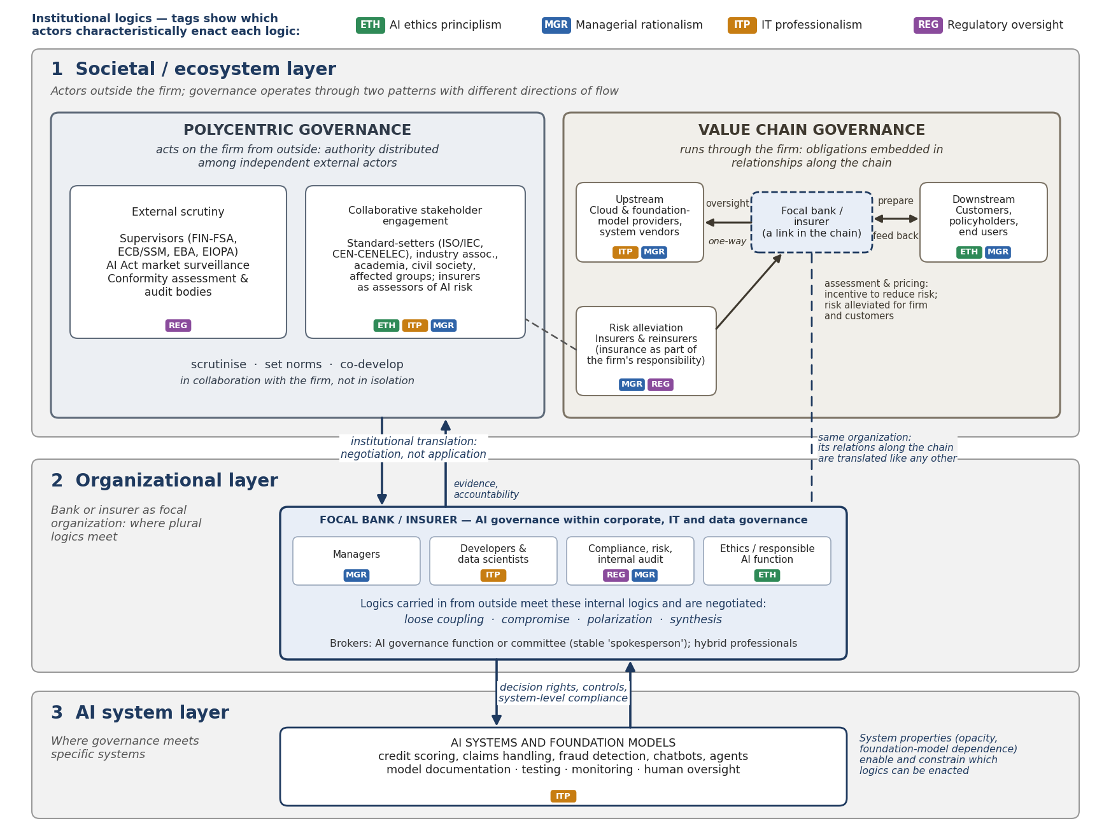
Responsible AI ecosystem model
Three layers
societal/ecosystem, organizational, AI system — pressures flow both down and up
Two patterns
polycentric governance acts on the firm; value chain governance runs through it
Four logics
who reasons how — they meet (and are negotiated) inside the firm
Translation
between layers: negotiation, not implementation
Notes:
[3:45–5:00] Here's the whole model on one page — I'll go through it piece by piece on the next slides. In short: responsible AI in banking and insurance is governed on three layers, with different actors and competing logics on each. On the ecosystem layer, governance runs through two patterns. And pressure from that layer doesn't just apply itself — it's translated inside the organization. So a bank's responsible AI position depends less on its internal framework than on how it's placed in, and acts on, this structure. Where the pieces come from: layers and logics from our layered institutional perspective, patterns from Khan & Mäntymäki, translation from Birkstedt et al.; the actor map is new in the report.

Slide 15
Responsible AI ecosystem model
1 Ecosystem
actors outside
the firm
Polycentric governance
acts on the firm from outside
e.g., supervisors, standard-setters
Value chain governance
runs through the firm
e.g., providers, customers, insurers
Three layers
societal/ecosystem, organizational, AI system — pressures flow both down and up
Two patterns
polycentric governance acts on the firm; value chain governance runs through it
translation: negotiation, not application
2 Organization
the bank or
insurer
Bank / insurer — plural logics meet and are negotiated
AI ethics
principlism
Managerial
rationalism
IT
professionalism
Regulatory
oversight
Four logics
who reasons how — they meet (and are negotiated) inside the firm
controls ↓ system properties ↑
Translation
between layers: negotiation, not implementation
3 AI system
specific systems
and models
AI systems in use
e.g., credit scoring, claims, fraud detection, chatbots
Notes:
[OPTION A — simplified figure, same layout as before. Delete the yellow tag and the other options.]
[3:45–5:00] Here's the model in its simplest form — I'll go through it piece by piece on the next slides. Responsible AI in banking and insurance is governed on three layers: the ecosystem around the firm, the bank or insurer itself, and the AI systems. On the ecosystem layer, governance runs through two patterns: polycentric governance acts on the firm from outside, value chain governance runs through it. Inside the firm, four logics meet and are negotiated. And pressure between the layers doesn't just apply itself — it's translated, in both directions. So a bank's responsible AI position depends less on its internal framework than on how it's placed in, and acts on, this structure. Where the pieces come from: layers and logics from our layered institutional perspective, patterns from Khan & Mäntymäki, translation from Birkstedt et al.; the full actor map is in the report.

