Slide 1
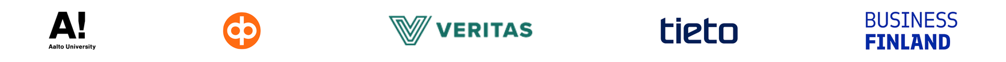
Towards Governing Generative AI: The Updated Hourglass Model of AI Governance
FLAIG Summit / 3 November 2026
Henrietta Jylhä
Senior Researcher, Information Systems Science
Turku School of Economics, University of Turku
e-mail: henrietta.jylha@utu.fi
Notes:
Thank you Teemu, and good afternoon everyone on my behalf as well. My name is Henrietta Jylhä, and I’m a Senior Researcher at Turku School of Economics in Information Systems Science. Today, I have the pleasure of introducing our AI Governance Framework, and more specifically, the updated Hourglass Model of Organizational AI Governance and the AI Governance task list that we have developed during the course of the FLAIG project.
I will explain in a moment what the Hourglass Model actually is and what were the grounds and means for updating it, as well as compare the previous model to the current one to demonstrate the changes, but let us first start with a little bit of an introduction on how the concept of AI governance has developed in these previous years. So let’s get started!

Slide 2

From narrow AI to GenAI governance
Earlier governance focus
(OECD lifecycle 2023):
Deploy
↓
Validate
↓
Approve
↓
Monitor
Today’s operating reality:
Externally sourced models
Open-endedness
Vendor-led model changes
Prompt-dependency, multi-source retrieval and guardrails.
The governance challenge:
Responsibility crosses organizational boundaries.
Controls must reflect the use context as well as technology.
Governing GenAI is complex; we need to think beyond governing an AI system in isolation.
Notes:
We can all probably agree that generative AI has made it very easy for organizations and individuals, practically everyone, to start using AI. But it has also made it harder to know exactly what we are governing.
Compared with the earlier era of narrow AI, when organizations often developed or acquired systems designed for a relatively specific task, the current landscape is much more varied. For example, now an organization might develop its own AI system, integrate an external model, or begin experimenting with AI agents. These situations create different governance questions and concerns. Let’s look at this through the three boxes on the slide.
First, earlier governance focus. When organizations developed or selected a more narrowly defined AI system, governance could often be organized around a relatively familiar sequence: develop or select the system, validate it, approve it, and then monitor its performance. These activities are still relevant today: but now there is more in the picture.
Which takes us to today’s operating reality. Organizations increasingly use models developed by external providers. Generative systems can produce a wide range of outputs, and the underlying model may change even when the organization itself has not changed its implementation. Governance must also consider things such as prompts, retrieval data and guardrails - not just the model itself.
So, here comes the governance challenge. Responsibility is now distributed across organizational boundaries. An organization may depend on a vendor for the model, manage the data and prompts itself, and remain responsible for how the system is used in their own context.
-> This means we need to think beyond governing an AI system in isolation. We need to govern how the system, the model and data, its suppliers and the organizational use fit together. And that is the challenge the updated Hourglass Model of Organizational AI Governance aims to address.

Slide 3
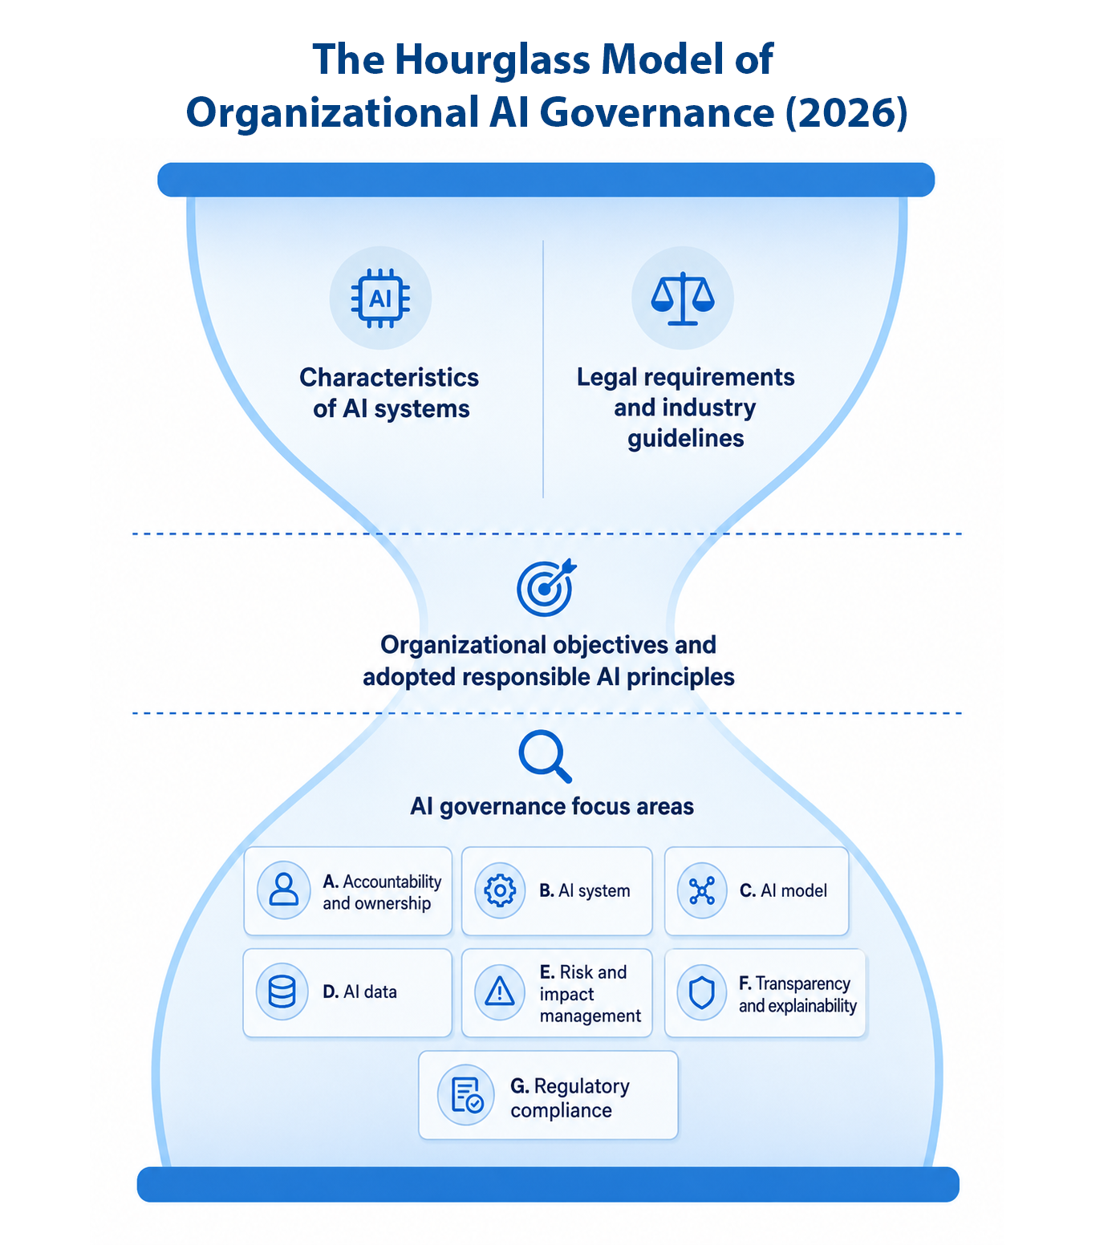
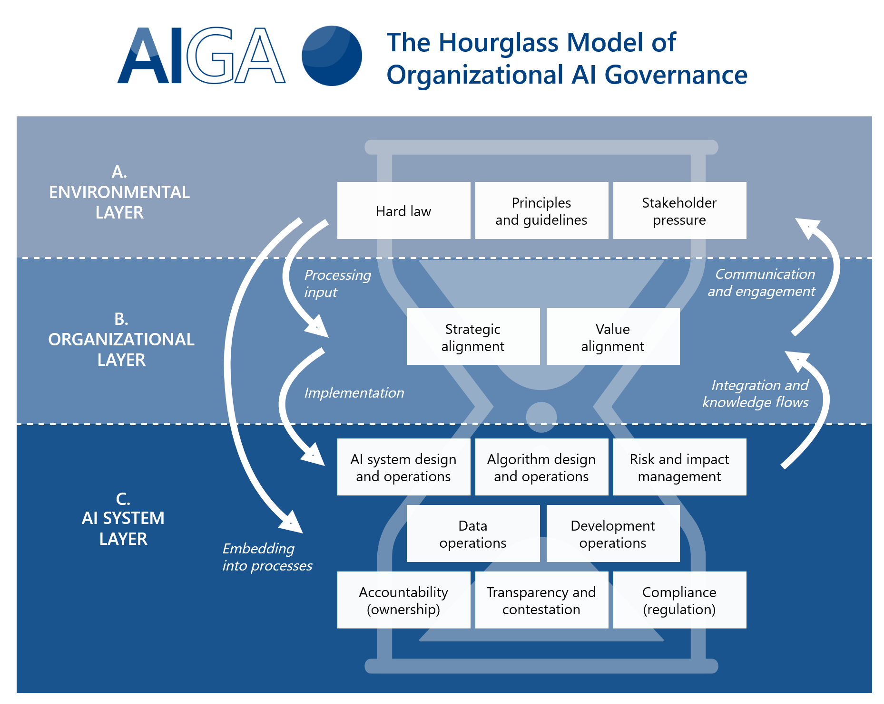
AI Governance Framework:
The Hourglass Model
Notes:
Let me introduce the Hourglass Model - and explain what were the grounds and means to the initial development of the model and its current update.
The Hourglass Model is a part of a larger concept called the AI Governance Framework. It also includes a detailed Task List of AI governance-related tasks.
The original model (as seen on the left) was created in the earlier, narrow-AI context, when organizations developed or selected AI systems designed for a relatively specific task. Even then, responsible AI governance required a structured way to connect organizational accountability with activities across AI system development and operations, such as data, risk and impact management, and regulatory compliance.
Hence, The Hourglass Model provides that overarching structure for overall AI governance, while the Task List introduces concrete governance tasks that organizations can adapt to their own context.
Generative AI has since then changed the environment. Organizations can now use general-purpose models from external providers, connect them to internal data, shape outputs through prompts and guardrails, and be affected by sudden model changes. The same model can be used in many contexts, and responsibility is often split between the provider and the organization deploying it.
The updated Hourglass Model (as seen on the right) makes these generative-AI-specific risks and controls more explicit, strengthens sourcing and vendor governance, clarifies human oversight and AI competence, and explains how tasks can be applied depending on an organization's role and technical access. In short, the structure remains the same – but the visual representation and the task list needed and update due to the realities of GenAI and externally sourced systems.

Slide 4
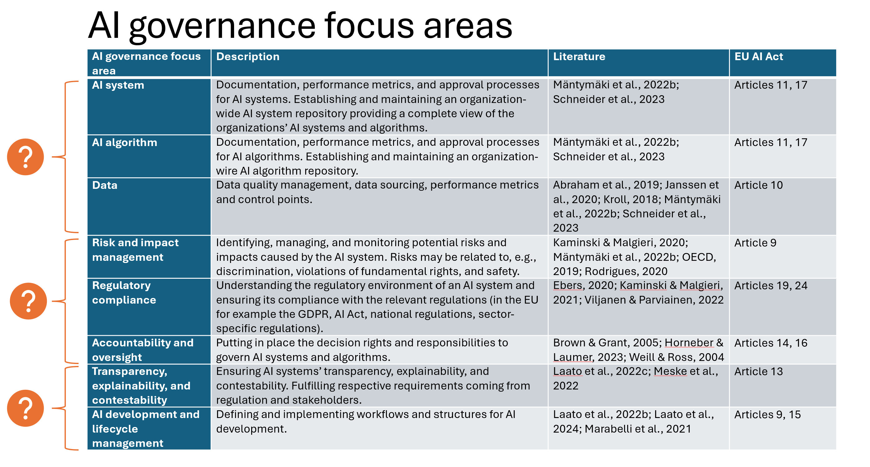
From expert insight to an updated Hourglass Model
23 expert interviews
Semi-structured interviews with experts working in the field of generative AI.
Co-design experiment
Participants reviewed the earlier focus areas and suggested additions, removals and refinements.
Follow-up evaluation
Webropol survey to all participants after initial updates.
Notes:
So, how did we scientifically approach this update? We started from examining the existing Hourglass Model, its Focus Areas and Task List.
To understand how it needed to evolve in the era of GenAI, we conducted semi-structured interviews with 23 experts working with generative AI. Importantly, the interviews were not just about asking experts what they thought of AI governance in general, but we also included a participatory co-design experiment, where the participants were invited to review the existing Focus Areas and suggest what should be retained, clarified, added or potentially even removed. The interview data was then coded and organized into broader categories, until main and subthemes were identified.
When mirroring the data with the previous Hourglass Model, we noticed that the main structure was actually still valid, but the individual tasks needed substantial refinement.
So, we used these insights to develop the 2026 Edition, in other words, the updated Hourglass Model and Task List.
After an initial round of updates, we conducted a follow-up evaluation survey, which gave us an indication of how the updated model was perceived by the experts. Now, let’s look at what actually changed in the Hourglass Model and Task List after the update.

Slide 5
What changed in the updated AI Governance Framework?
Generative AI and general-purpose model risks: Prompts and guardrails, model changes, output evaluation and GPAI risk assessment.
Stronger vendor and sourcing governance: Sourcing responsibilities, documentation, information duties and change notifications.
The provider and deployer roles: Clearer conventions for applying tasks proportionately.
Clearer human oversight and AI competence: More explicit ownership, human oversight, competence and training.
Transparency and explainability: Grounded in what stakeholders need.
Notes:
Here you can see highlighted five developments in the updated Hourglass Model.
The first is more explicit controls for generative AI. This includes managing prompts and guardrails, tracking changes to models, evaluating generated outputs, and considering the specific risks associated with general-purpose AI models.
The second development is stronger vendor and sourcing governance. When organizations rely on external AI models and services, they need to understand what their suppliers are responsible for, what information and documentation they can obtain, and how changes or incidents will be handled.
The third is the distinction between providers and deployers. The updated version introduces clearer conventions for applying tasks proportionately to an organization's regulatory role and its access to the underlying technology.
The fourth is clearer human accountability. The updated model makes responsibilities for AI systems more explicit, including human oversight, AI competence and training. Having an AI system in place is not enough; organizations also need people who understand their responsibilities and can intervene when necessary.
The fifth is more grounded transparency and explainability according to stakeholders’ needs.
Let me make the changes more concrete by highlighting some examples from the updated Task List.

Slide 6
A few concrete examples of changes…
GenAI & GPAI risks
Vendor & sourcing
Provider & deployer roles
E2 · expanded task
A6, B3 · dedicated task content
A2, C, G1 · application conventions
Assess systemic risks, capability limits, misuse, and fine-tuning risks.
Clarify vendor responsibilities, information duties, change notifications and incident cooperation.
Apply tasks to the organization’s role and access; document gaps and compensating measures.
Human oversight & competence
Transparency & explainability
A4, A5 · new dedicated tasks
F1–F5 · clarified and extended
Define oversight responsibilities and equip people to understand, supervise and respond to AI risks.
Assess stakeholder needs, design suitable measures and validate, monitor and review them.
Notes:
So, first example, generative AI and general-purpose AI risks. The previous model already included model risk assessment. But now in the updated version, task E2 explicitly extends this to GPAI-specific risks, including systemic risks, capability limitations, misuse, and risks arising from fine-tuning.
Second, sourcing and vendor governance. The updated version gives this area much more explicit attention, including the AI system sourcing and vendor governance task. Organizations are prompted to consider not only which system they acquire, but also vendor responsibilities, documentation and information duties, change notifications, and cooperation when incidents occur.
Third, the distinction between providers and deployers. For example, a deployer may not be able to inspect a model or control its release cycle. The organization should then document the limitation and identify appropriate contractual or monitoring measures. The updated model also introduces the AI Model Owner role, where “Each AI system should have an organizational owner accountable for its development, deployment, operations, and ultimately, retirement in cooperation with the Head of AI.”
Fourth, human oversight and AI competence. Human oversight and AI competence and training now have their own explicit tasks, A4 and A5. This makes it clearer that governance requires defined oversight responsibilities and people with the competence to carry them out.
Finally, transparency and explainability. The earlier model already included transparency, explainability and contestability, so these are not entirely new concepts. The updated version reframes the focus area around transparency and explainability and extends the task descriptions. The emphasis is on assessing what stakeholders need, designing appropriate measures, validating them, and monitoring and reviewing them.
So, the overall change is more explicit treatment of the governance challenges that arise when AI is generative, externally sourced and used in different organizational and regulatory roles.

Slide 7
First impressions of the updated Hourglass Model from experts (survey results)
1. What was welcomed:
Usefulness and organizational relevance, a clear top-down structure, and changes in transparency & explainability.
2. What could be clarified:
Some tasks may be too high-level, AI system vs. AI model distinction, and overlapping impact tasks need clarification.
3. What needs more attention:
Agent autonomy and access rights, cybersecurity incidents, stakeholder engagement, and lifecycle issues.
4. Practical concern:
Governance can become a tick-box exercise if tasks are not translated into context-specific practice.
Notes:
Now, after the brief introduction to the updated model, I’d like to share some initial feedback that we received from the experts about the changes. As previously mentioned, we sent out a follow-up evaluation survey to all 23 participants after the round of initial changes had been made to the Hourglass Model and Task List. So, what did the experts think of the updated model?
Overall, the feedback was very encouraging. Respondents recognized the model’s usefulness and organizational relevance, and some specifically welcomed its treatment of transparency and explainability. The top-down structure was also seen as useful.
At the same time, the feedback highlighted areas where the model could still be improved. One concern was that some tasks remain quite high-level. A reference model can help organizations identify what they need to address, but practitioners may also need more concrete guidance on how to do it. Participants also raised questions about the distinction between an AI system and an AI model, as well as potential overlap between some of the impact-management tasks.
Another emerging theme was the need to address AI agent autonomy explicitly, because access rights, cybersecurity implications, and lifecycle management can create additional governance challenges.
Finally, there was a concern that governance could become a tick-box exercise in that organizations might document that tasks have been completed without necessarily changing their practices.
These comments are valuable because they remind us that a comprehensive framework is only one part of the solution. It also needs to be understandable, applicable and connected to real organizational work.

Slide 8




Who is the model for and how to utilize it?
In practice:
Map existing practices against relevant tasks
Identify gaps for the specific system and use case
Assign owners, document constraints and compensating measures, then revisit.
Organizations in
finance
The public sector
Credit assessment, fraud detection, risk management, and customer service.
Fairness, transparency, accountability, and the appropriate role of automation in public decision-making.
IT services
Develop, integrate, customize, or supply AI systems for other organizations.
Reference model – not a mandatory checklist.
Notes:
The updated Hourglass Model and Task List are intended for organizations across sectors, and it can help different stakeholders around AI systems work from a shared structure.
First, organizations in finance. Financial institutions operate in highly regulated environments where decisions can directly affect a customer’s financial security and access to services. Their decisions must be reliable, accountable, and compliant with regulatory requirements, while managing risks and maintaining customer trust. The Hourglass Model can be particularly useful where risk management and regulatory obligations are central.
Second, the public sector. Public organizations can use the model to consider legal obligations, public responsibilities and the needs of affected stakeholders when deciding how AI should be used. The task list can help them document decisions, assign responsibility and ensure that risks and impacts are considered in the actual service context.
Third, IT services. Organizations that develop, integrate or supply AI systems can use the model to structure their own governance work and clarify what documentation, information and change communication they provide to customers. This can support clearer responsibilities between the provider and the organization deploying the system.
In practice, an organization could begin by mapping its existing governance practices against the relevant tasks. It could then identify gaps for a particular AI system or use case, assign responsibilities, and decide how those gaps should be addressed.
But there is an important distinction here: the Hourglass Model is a reference model, not a mandatory checklist. The tasks need to be adapted to the organization’s context, the system’s risks, the organization’s role and the information or technical access available to it. For example, an organization using an external model may not be able to inspect the model itself. In that case, it needs to understand those limitations and consider what other controls or safeguards are possible.

Slide 9

Demo of the interactive Hourglass Model
Let’s explore the model
(Select a focus area to explore its tasks and detailed descriptions)
Notes:
I’d now like to show you how the updated Hourglass Model can be explored in practice. We have made the model available in an interactive format on the FLAIG website. With the interactive model, you can explore the focus areas and the associated governance tasks fully.
[Open the interactive model.]
I’ll start with accountability and ownership. This focus area provides the organizational foundation: who is responsible for AI governance, how responsibilities are assigned at the system level, and how human oversight and competence are addressed.
[Open the accountability and ownership focus area.]
Next, let’s look at the AI system focus area. These tasks help organizations consider the responsibilities that arise with AI systems in general, and also, when they rely on external AI systems or models, including documentation, supplier communication and changes introduced by a provider.
[Open the relevant vendor-governance and version-control tasks.]
Finally, we can look at risk management. The updated model makes the relevance of generative AI and general-purpose AI more explicit, including the assessment of potential harms, model limitations and risks associated with fine-tuning.
[Open the relevant risk-management tasks.]
The important point is that these tasks are connected. A change in a model can affect system validation, risk assessments, monitoring and potentially regulatory compliance. The framework helps organizations see these issues as parts of a broader governance process rather than as separate, isolated activities.
The interactive version is intended to make that structure easier to navigate and help practitioners identify the tasks most relevant to their own context. You can freely explore the model in more detail on the FLAIG website, I can paste the link into the chat soon.

Slide 10

What’s next?
Examine: Tailor relevant tasks to organizations’ needs (role, risk, and use context).
Validate: Naturalistic organizational validation is planned.
Evolve: Future work should strengthen practical guidance and address agentic AI governance in more depth.
Notes:
To conclude, the updated Hourglass Model aims to bring organizational AI governance closer to the realities of GenAI and externally sourced models.
The next step is to:
First, Examine how organizations can apply the updated Hourglass Model in practice, and what guidance they need to make it useful.
Second, Perform a naturalistic validation in an organizational setting, which is planned to take place in the near future.
And third, Conduct further research to address emerging challenges, including AI governance for AI agents.
Ultimately, the goal is “less governance documentation for its own sake – and more governance practices that are meaningful and effective in their actual operating contexts.”

Slide 11
Thank you.
Kiitos.
Notes:
That’s it for my part! Hope you enjoyed the presentation and thank you for listening.

Slide 13















































































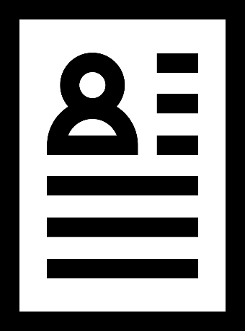
Icons

Slide 14





Photos
Download photos from mediabank:
mediabank.utu.fi

